Slide 1
Chapter 8
Digital Filter Structures

Slide 2
Main Contents
1
Block Diagram Representation of the LTI Digital Filter
2
Basic FIR Filter Structure
3
Basic IIR Filter Structure

Slide 3
Block Diagram Representation of Digital Filter
Basic Building Blocks
Delay-Free Loop Problem
Canonic & Equivalent Structure
Mooc 内容

Slide 4
Introduction
The actual implementation of an LTI digital filter could be either in software or hardware form, depending on applications.
The structural representation provides the relations between some pertinent internal variables with the input and the output that in turn provide the keys to the implementation.
In this lecture, we will focus on the block diagram representation of FIR and IIR digital filters
Mooc 内容

Slide 5
Introduction
How can we realize those filters?
For a LTI FIR system we know
For a LTI IIR system
The above representations are not clear enough for us to implement those filters (such as in hardware form or improving our algorithms).

Slide 6
Digital filter Structures
The convolution sum description of an LTI discrete-time system can, in principle, be used to implement the system
For an IIR finite-dimensional system this approach is not practical as here the impulse response is of infinite length
However, a direct implementation of the FIR finite-dimensional system is practical
The structural representation provides the relations between some pertinent internal variables with the input and the output that in turn provide the keys to the implementation.

Slide 7
Basic Building Blocks
The basic building blocks and signal-flowing diagram
adder
multiplier
pick-off node
Mooc 内容

Slide 8
Basic Building Blocks
unit delay
unit advance
modulator
Mooc 内容

Slide 9
Basic Building Blocks
Example:
Its block diagram is as below:
Mooc 内容

Slide 10
Block Diagram Representation
The advantages of block diagram representation:
Easy to write down the computational algorithm
Easy to determination the relation between the input and output
Easy to derive other “equivalent” block diagram yielding different algorithms
Easy to determine the hardware requirements
Mooc 内容

Slide 11
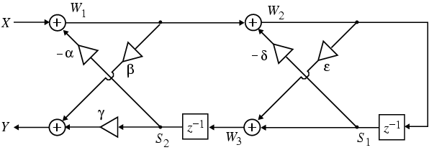
Example:
Analyze the cascaded lattice structure shown below:
The output signals of the four adders are given by:
W₁= X - αS₂ W₂= W₁ - δS₁
W₃= S₁ + εW₂ Y= βW₁ + γ S₂
And S₂= z⁻¹ W₃ S₁= z⁻¹ W₂
So，W₁=X- α z⁻¹ W₃ W₂= W₁ - δ z⁻¹ W₂
W₃= z⁻¹ W₂ + εW₂ Y= βW₁ + γ z⁻¹ W₃

Slide 12
From the second and third equation we get:
W₂= W₁ /(1+δ z⁻¹ ), W₃=(ε + z⁻¹ )W₂
Combining these equations we get:
Substituting the above equation in
We finally arrive at:

Slide 13
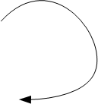
Delay-Free Loop
The Delay-Free Loop Problem
Output y[n] depends on y[n] itself. Physically impossible !
Mooc 内容

Slide 14
Delay-Free Loop
The Delay-Free Loop Problem
Delay-free loop
No delay-free loop
Mooc 内容

Slide 15
Canonic & Equivalent Structure
Canonic structure
The number of delays = the order of the difference equation
Example
Non-canonic structure
Canonic structure
Mooc 内容

Slide 16
Canonic & Equivalent Structure
Equivalent structure via transpose operation
(1) Reverse all paths
(2) Replace pick-off nodes by adders, and vice versa
(3) Interchange the input and the output nodes
Mooc 内容

Slide 17
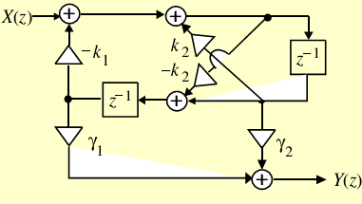
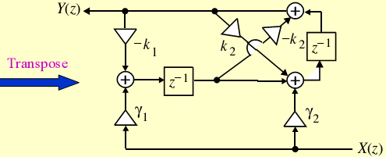
Example:
Original structure
Transposed structure

Slide 18
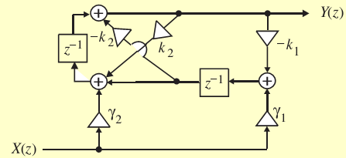
Redrawn transposed structure is shown below:
There are literally an infinite number of equivalent structures realizing the same transfer function.
Under infinite precision arithmetic any given realization of a digital filter behaves identically to any other equivalent structure.
However, due to the finite word-length limitations, a specific realization behaves totally differently from its other equivalent realizations.
Hence, it is important to choose a structure that has the least quantization effects when implemented using finite precision arithmetic.

Slide 19
Basic FIR & IIR Digital Filter Structure
FIR Filter Structure
IIR Filter Structure
Mooc 内容

Slide 20
Basic FIR Filter Structure
Direct Form
A causal FIR filter of order N
and its transpose
Direct form is canonic structure
Mooc 内容

Slide 21
Basic FIR Filter Structure
Cascade Form
where H(z) is divided into 1st-order (i.e., β_{2k} =0) or 2nd-order (i.e., β_{2k} ≠0) transfer functions.
Cascade form is also canonic structure
Mooc 内容

Slide 22
8.3 Basic FIR Filter Structure
8.3.3 Polyphase realization
See Fig8.7c
See Fig8.7b
See Fig8.7a
(掌握)

Slide 23
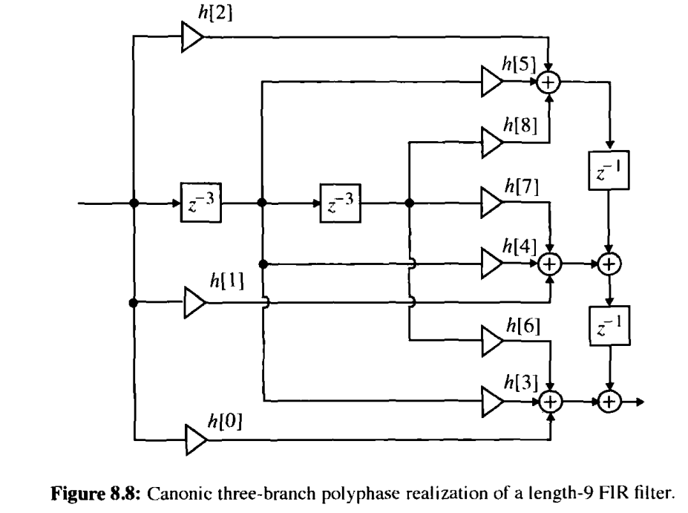
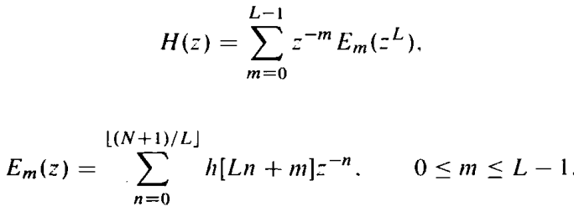
8.3.3 Polyphase realization
Notes:
The polyphase structures are often used in multirate digital signal processing applications for computation efficient realizations.

Slide 24
8.3 Basic FIR Filter Structure
8.3.4 Linear-Phase FIR Structures
Linear-Phase FIR filter, h[n] is symmetric, or antisymmetric:
The characterization can reduce the number of multipliers (almost a half) in direct form.
(掌握)

Slide 25
8.3 Basic FIR Filter Structure
Example:
The implementations of length 7 and 8 with symmetric impulse response :
It is noted that a similar savings occurs in the case of an FIR filter with an antisymmetric impulse response.
(掌握)

Slide 26
8.3 Basic FIR Filter Structure
(掌握)

Slide 27
8.3 Basic FIR Filter Structure
Example: Given an FIR filter as below
Its cascade form structure is wanted.
Solution:
(掌握)

Slide 28
8.3 Basic FIR Filter Structure
(掌握)

Slide 29
8.3 Basic FIR Filter Structure
Its cascade form structure is as below:
(掌握)

Slide 30
8.4 Basic IIR Filter Structure
Direct Form
A possible realization scheme
Mooc 内容

Slide 31
Basic IIR Filter Structure
Mooc 内容

Slide 32
H(z)=H₁(z)H₂(z)
Transpose
H(z)=H₂(z)H₁(z)
Transpose
MOOC

Slide 33
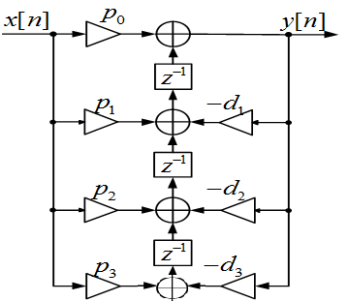
canonic structure
H(z)=H₂(z)H₁(z)
Transpose
MOOC
Mooc 内容

Slide 34
Basic IIR Filter Structure
Cascade Form
It is easy to modify zeros and poles.
But the forms of realization are no identical.
Mooc 内容

Slide 35
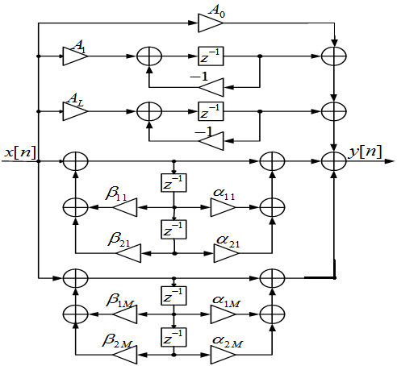
Basic IIR Filter Structure
Parallel Form
It is needed partial-fractional expansion
It is easy to modify poles with identical form
Mooc 内容

Slide 36
Basic IIR Filter Structure
Example: For a system as below
Its transfer function is
Mooc 内容

Slide 37
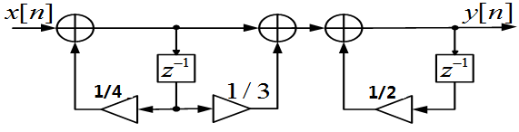

Basic IIR Filter Structure
Its direct form
The cascade form with 1st order
$$H(z)=\frac{1+\frac{1}{3}z^{−1}}{1−\frac{3}{4}z^{−1}+\frac{1}{8}z^{−2}}$$
The parallel form with first-order
Mooc 内容

Slide 38
8.4 Basic IIR Structure
Example For a system as below
Its direct form is as below
(掌握)

Slide 39
8.4 Basic IIR Structure
Its cascade form with second-order
(掌握)

Slide 40
8.4 Basic IIR Structure
Its paralle form with second-order
(掌握)

Slide 41
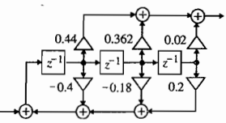
Example:
Consider the third-order IIR transfer function:
Then given the direct form II realization of H(z)

Slide 42
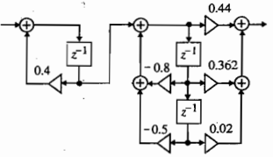
Consider the IIR transfer function --- cascade realization:
Another cascade realization—noncanonic

Slide 43
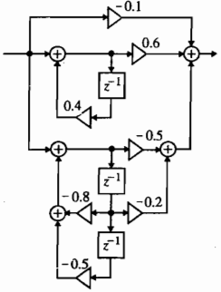
A partial-fraction expansion of
in z⁻¹ yields:
parallel form I realization

Slide 44
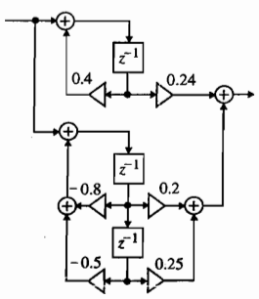
Likewise, a partial-fraction expansion of H(z) in z yields:
parallel form II realization

Slide 45
8.5 Realization Using MATLAB
The cascade form requires the factorization of the transfer function which can be developed using the M-file zp2sos
The statement sos = zp2sos(z,p,k) generates a matrix sos containing the coefficients of each 2nd-order section of the equivalent transfer function H(z) determined from its pole-zero form

Slide 46
whose i-th row contains the coefficients {p_{il}} and {d_{il}}, of the the numerator and denominator polynomials of the i-th 2nd-order section.
L denotes the number of sections.
The factorization of the transfer function also can be developed by using tf2sos.

Slide 47
Parallel Realization
Parallel forms I and II can be developed using the functions residuez and residue, respectively.
Program 8_1&8_2
Program 8_3

Slide 48
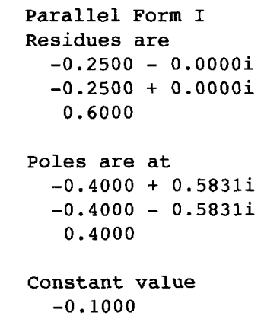
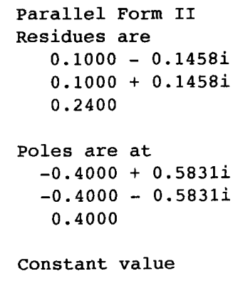
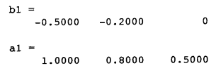
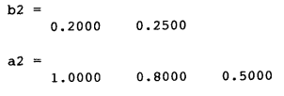
%Ex 8_3
num = [0 0.44 0.362 0.02]; %input('Numerator coefficient vector = ');
den = [1 0.4 0.18 -0.2]; %input('Denominator coefficient vector = ');
[sos,g] = tf2sos (num, den); %cascade
[r1,p1,k1] = residuez(num,den); %Parallel Form I
%disp('Residues are');disp(r1); disp('Poles are at');disp(p1); disp('Constant');disp(k1);
[r2,p2,k2] = residue(num,den); %Parallel Form II
%disp('Residues are');disp(r2); disp('Poles are at');disp(p2); disp('Constant');disp(k2);
R1 = [r1(1) r1(2)]; P1 = [p1(1) p1(2)];
[b1,a1] = residuez(R1,P1,0);
R2 = [r2(1) r2(2)]; P2 = [p2(1) p2(2)];
[b2,a2] = residuez(R2,P2,0);

Slide 49
Computational Complexity of Digital Filter Structure
Computational complexity comparison of various realization of an FIR filter of order N
structure | No. of multipliers | No. of two-input adders
Direct form Cascade form Polyphase Cascade lattice Linear phase | N+1 N+1 N+1 2(N+1) INT[(N+2)/2] | N N N 2N+1 N

Slide 50
Computational complexity comparison of various realization of an IIR filter of order N
structure | No. of multipliers | No. of two-input adders
Direct form II and II_{t} Cascade form Parallel form | 2N+1 2N+1 2N+1 | 2N 2N 2N

Slide 51
Homework
Problems
8.5, 8.11, 8.13, 8.25, 8.28, 8.33, 8.35
M8.1, M8.2, M8.3

